Slide 1
Module 8 Uber Supply-Demand Gap Analysis - EDA
PRITHVIRAJ P. PATIL
Batch : UOA Master of Science in Data Science C5

Slide 2
agenda
Business Objective
Task 1 : Data Cleaning
Task 2 : Univariate Analysis
Task 3 : Bivariate Analysis
Task 4 : Deriving New Metrics
Task 5 : Graphical Analysis
Hypothesis
Conclusions

Slide 3

Business Objective
The aim of analysis is to identify the root cause of the problem (i.e., cancellation and non-availability of cars) and recommend ways to improve the experience of travelling to and from the airport using Uber
Reduce impact of revenue to business of Uber if drivers cancel the request of riders or if cars are unavailable

Slide 4
Task 1.1 : Data Cleaning → Import and read
Import Packages
Numpy, pandas, matplotlib.pyplot, seaborn, datetime, warnings
Read Data uber_req
pd.read_csv
Correcting the Datatypes
pd.to_datetime for "Request and Drop timestamp" columns
Removing unnecessary columns
uber_req.drop "Driver id"
No Duplicate values found uber_req.duplicated()

Slide 5
Task 1.2 : Data Cleaning → Understand the Dataset
Unique pickup points are present in uber_req
['Airport' 'City']
Observations present in uber_req.shape total 6745 rows and 5 columns
(6745, 5)
Data columns (total 5 columns)
Request id, Pickup point, Status, Request timestamp, Drop timestamp
Inspecting the null values
Null values are found only in column Drop timestamp i.e., 3914
with Status as
Cancelled 1264
No Cars Available 2650
NOTE:
Drop timestamp rows are empty when the Status is No Cars Available or Cancelled. Since the trips did not happen in those cases, the Drop timestamp can not be available, hence the null values here are valid.

Slide 6
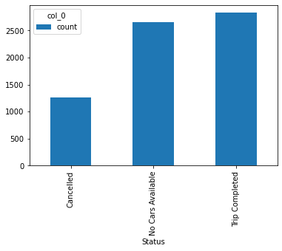
Task 2 : Univariate Analysis
As per the Univariate Analysis conclusion of Status column is that "No cars available" is more than the number of trips cancelled.

Slide 7
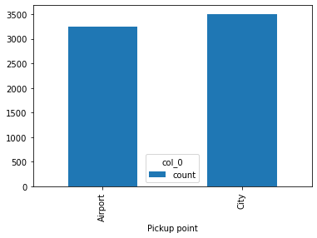
Task 2 : Univariate Analysis
As per the Univariate Analysis conclusion of Pickup Point column is that the pickups at "Airport" as well as "City" are nearly same in dataset

Slide 8
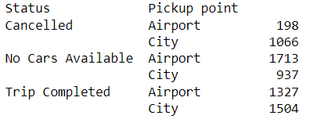
Task 3 : Bivariate Analysis
Grouping by Status and Pickup point.

Slide 9
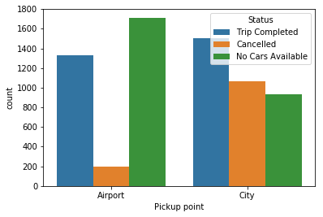
Task 3 : Bivariate Analysis
Visualizing the count of Status and Pickup point bivariate analysis. We conclude
There are more No cars available from Airport to City.
There are more cars Cancelled from City to Airport.

Slide 10
Task 4 : Deriving New Metrics
Create New columns Request Time Slot & Request Hour and
using the function between(start, end, inclusive=True) . It checks for the time value present between the start and the end value
Early Morning
0 - 4
Morning
5 - 8
Late Morning
9 -12
Noon
13 -16
Evening
17 - 20
Night
21 - 24
Demand = Include trips completed, cancelled or no cars available . New Column with 1 as a value
Supply = Trips completed, rest all are excluded, so we will create a column with 1 as a supply value trips completed and 0 otherwise.
Gap = Difference between Demand and Supply
Gap = 0 , Trip Completed
Gap = 1, Trip Not Completed

Slide 11
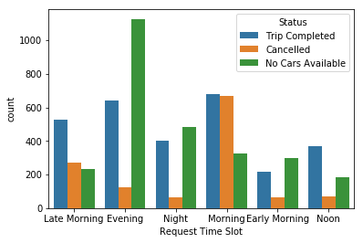
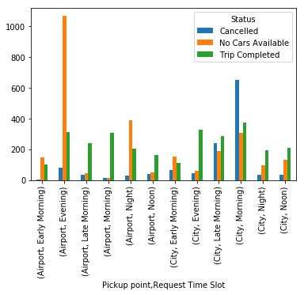
Task 5 : Graphical Analysis
Plot to find the count of the three requests, according to the defined time slots. Conclusions from plot :
Most No Cars Available are in the Evening.
Most Cancelled trips are in the Morning.
Plot to find the count of the status, according to both pickup point and the time slot. Conclusions from plot :
Most No Cars Available are in the Evening from Airport to City.
Most Cancelled trips are in the Morning from City to Airport.

Slide 12
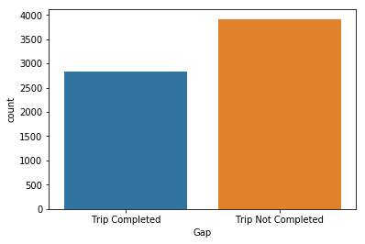
Task 5 : Graphical Analysis
Plot to count the number of requests that was completed, and which was not. Conclusions from plot :
More Trip not completed than Trip Completed.

Slide 13
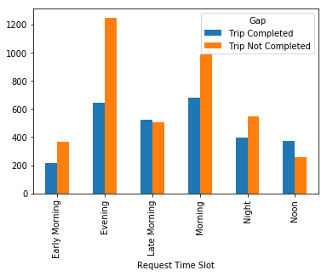
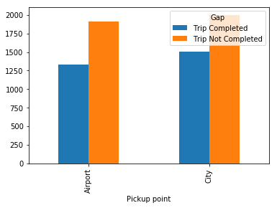
Task 5 : Graphical Analysis
Plot to count the number of requests that was completed, and which was not, against the time slot
Plot to count the number of requests that was completed, and which was not, against the pickup point

Slide 14
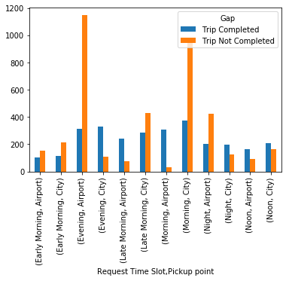
Task 5 : Graphical Analysis
Plot to count the number of requests that was completed, also those which was not, for the final analysis

Slide 15
Hypothesis
Pickup Point - City :
Pickup Point - Airport :
As per the analysis, the morning time slot is most problematic where the requests are being cancelled. Most probably the requests are being cancelled by the drivers due to the morning rush as it being the office hours and seeing the destination as airport which would be too far, the driver would think to earn more for the shorter trips within the city.
Upon analysis, the evening time slot seems to be most problematic for pickup points as airport where the requests being No Cars Available. The reason seems to be that not enough cars are available to service the requests as cars might not be available at the airport due to the cars serving inside the city.

Slide 16

Conclusions :
Based on the data analysis performed, following recommendation can be used by Uber to bridge the gap between supply and demand: -
For bridging the demand supply gap from airport to city, making a permanent stand in the airport itself where the cabs will be always available, and the incomplete requests can come down significantly.
Uber can provide some incentives to the driver who complete the trip from city to airport in the morning part. This might result the driver to not cancel the request from city to airport trips.
Last but sure solution to bring down the gap is to increase the numbers of cab in its fleet.

Slide 17
Thank You
PRITHVIRAJ P. PATIL

